Slide 1


Smart Mobility Engineering Lab (IGS3231) Week 4 Lecture
ISE Department
Prof. Mehdi Pirahandeh

Slide 2
Content
Introduction to Embedded System Design
Application Examples
Q & A
Survey

Slide 3
Managing Dependencies with rosdep
Goal: Manage external dependencies using rosdep
What is rosdep?
rosdep is ROS’s dependency management utility that can work with ROS packages and external libraries. rosdep is a command-line utility for identifying and installing dependencies to build or install a package. It can be or is invoked when:
Building a workspace and needing appropriate dependencies to build the packages within
Install packages (e.g. sudo apt install ros-foxy-demo-nodes-cpp) to check the dependencies needed for it to execute
It has the ability to work over a single package or over a directory of packages (e.g. workspace).

Slide 4
Managing Dependencies with rosdep
How does rosdep work?
rosdep will check for package.xml files in its path or for a specific package and find the rosdep keys stored within. These keys are then cross-referenced against a central index to find the appropriate ROS package or software library in various package managers. Finally, once the packages are found, they are installed and ready to go!
The central index is known as rosdistro, which may be found here. We’ll explore that more in the next section.
How do I know what keys to put in my package.xml?
For ROS packages (e.g. nav2_bt_navigator), you may simply place the name of the package. You can find a list of all released ROS packages in rosdistro at <distro>/distribution.yaml for your given ROS distribution.
For non-ROS package system dependencies, we will need to find the keys for a particular library. In general, there are two files of interest: rosdep/base.yaml and rosdep/python.yaml. base.yaml in general contains the apt system dependencies. python.yaml in general contains the pip python dependencies.

Slide 5
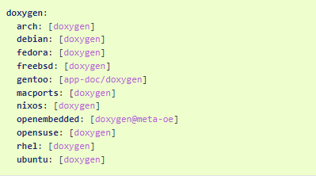
Managing Dependencies with rosdep
To find a key, search for your library in this file (preferably ctrl+F, its long) and find the name in yaml that contains it. This is the key to put in a package.xml file.
For example, imagine a package had a dependency on doxygen because it is a great piece of software that cares about quality documentation (hint hint). We would search base.yaml for doxygen and come across:
That means our rosdep key is doxygen, which would resolve to those various names in different operating system’s package managers for installation.

Slide 6

Managing Dependencies with rosdep
What if my library isn’t in rosdistro?
If your library isn’t in rosdistro, you can experience the greatness that is open-source software development: you can add it yourself! Pull requests for rosdistro are typically merged well within a week.
How do I use the rosdep tool?
Now that we have some understanding of rosdep, package.xml, and rosdistro, we’re ready to use the utility itself! Firstly, if this is the first time using rosdep, it must be initialized via:
This will initialize rosdep and update will update the locally cached rosdistro index. It is a good idea to update rosdep on occasion to get the latest index.
Finally, we can run rosdep install to install dependencies. Typically, this is run over a workspace with many packages in a single call to install all dependencies. A call for that would appear as the following, if in the root of the workspace with directory src containing source code.

Slide 7
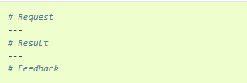
Creating and action
Goal: Define an action in a ROS 2 package.
Step 1 Defining an action
Actions are defined in .action files of the form:
An action definition is made up of three message definitions separated by ---
A request message is sent from an action client to an action server initiating a new goal.
A result message is sent from an action server to an action client when a goal is done.
Feedback messages are periodically sent from an action server to an action client with updates about a goal.

Slide 8

Creating and action
Say we want to define a new action “Fibonacci” for computing the Fibonacci sequence.
Create an action directory in our ROS package action_tutorials_interfaces:
Within the action directory, create a file called Fibonacci.action with the following contents:
The goal request is the order of the Fibonacci sequence we want to compute, the result is the final sequence, and the feedback is the partial_sequence computed so far.

Slide 9

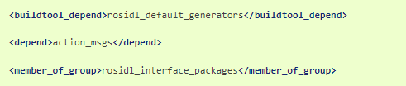
Creating and action
Building an action
Before we can use the new Fibonacci action type in our code, we must pass the definition to the rosidl code generation pipeline.
This is accomplished by adding the following lines to our CMakeLists.txt before the ament_package() line, in the action_tutorials_interfaces:
We should also add the required dependencies to our package.xml:

Slide 10

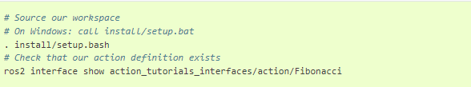
Creating and action
Note, we need to depend on action_msgs since action definitions include additional metadata (e.g. goal IDs).
We should now be able to build the package containing the Fibonacci action definition:
By convention, action types will be prefixed by their package name and the word action. So, when we want to refer to our new action, it will have the full name action_tutorials_interfaces/action/Fibonacci.
We can check that our action built successfully with the command line tool:

Slide 11
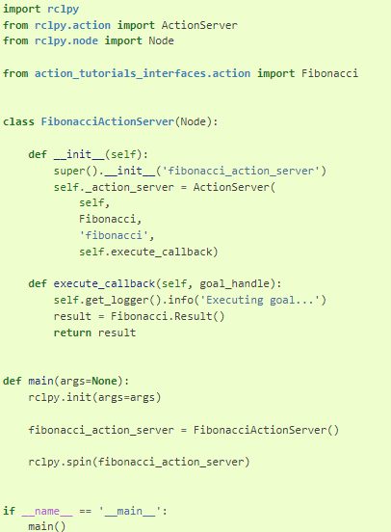
Writing an action server and client
Goal: Implement an action server and client in Python.
Writing an action server
Open a new file in your home directory, let’s call it fibonacci_action_server.py, and add the following code:

Slide 12
Writing an action server and client
An action server requires four arguments:
A ROS 2 node to add the action client to: self.
The type of the action: Fibonacci (imported in line 5).
The action name: 'fibonacci’.
A callback function for executing accepted goals: self.execute_callback. This callback must return a result message for the action type.
Run action server
python3 fibonacci_action_server.py
In another terminal, we can use the command line interface to send a goal:
ros2 action send_goal fibonacci action_tutorials_interfaces/action/Fibonacci "{order: 5}“

Slide 13
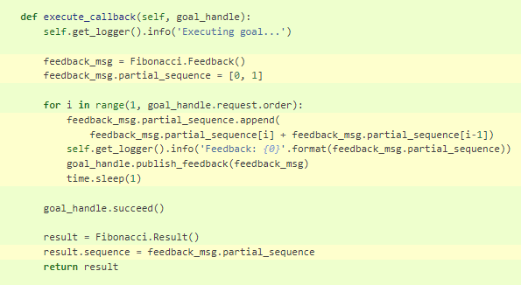
Writing an action server and client
Publishing feedback
We can make our action server publish feedback for action clients by calling the goal handle’s publish_feedback() method. We’ll replace the sequence variable and use a feedback message to store the sequence instead.
Changes are highlighted in yellow need to be applied the code written before. After restarting the action server, we can confirm that feedback is now published by using the command line tool with the --feedback option:
ros2 action send_goal --feedback fibonacci action_tutorials_interfaces/action/Fibonacci "{order: 5}"

Slide 14
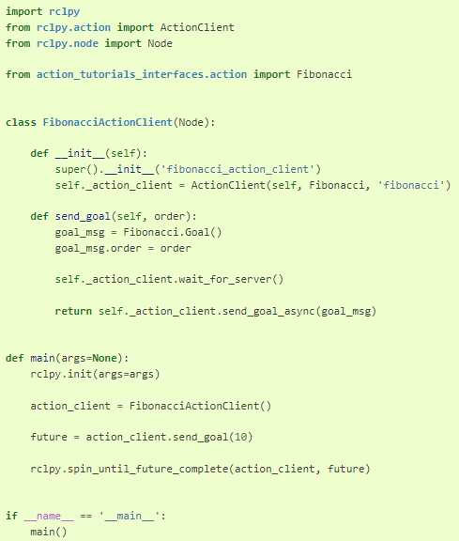
Writing an action server and client
Writing an action client
We’ll also scope the action client to a single file. Open a new file, let’s call it fibonacci_action_client.py, and add the following code:

Slide 15
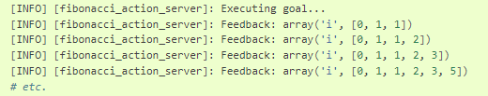
Writing an action server and client
To test the code run the following commands on terminal:
python3 fibonacci_action_server.py
python3 fibonacci_action_client.py
You should see messages printed by the action server as it successfully executes the goal:
At this point, we have a functioning action client, but we don’t see any results or get any feedback.

Slide 16
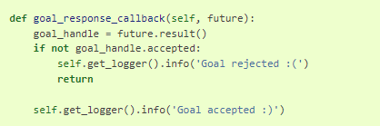
Writing an action server and client
Getting a result
So, we can send a goal, but how do we know when it is completed? We can get the result information with a couple steps. First, we need to get a goal handle for the goal we sent. Then, we can use the goal handle to request the result.
The ActionClient.send_goal_async() method returns a future to a goal handle. First, we register a callback for when the future is complete:
self._send_goal_future.add_done_callback(self.goal_response_callback)
Note that the future is completed when an action server accepts or rejects the goal request. Let’s look at the goal_response_callback in more detail. We can check to see if the goal was rejected and return early since we know there will be no result:

Slide 17

Writing an action server and client
Getting a result
Now that we’ve got a goal handle, we can use it to request the result with the method get_result_async(). Similar to sending the goal, we will get a future that will complete when the result is ready. Let’s register a callback just like we did for the goal response:
In the callback, we log the result sequence and shutdown ROS 2 for a clean exit:
With an action server running in a separate terminal, go ahead and try running our Fibonacci action client!
python3 fibonacci_action_client.py
You should see logged messages for the goal being accepted and the final result.

Slide 18

Writing an action server and client
Our action client can send goals. Nice! But it would be great if we could get some feedback about the goals we send from the action server.
Here’s the callback function for feedback messages:
In the callback we get the feedback portion of the message and print the partial_sequence field to the screen. We need to register the callback with the action client. This is achieved by additionally passing the callback to the action client when we send a goal:
self._send_goal_future = self._action_client.send_goal_async(goal_msg, feedback_callback=self.feedback_callback)
We’re all set. If we run our action client, you should see feedback being printed to the screen.

Slide 19
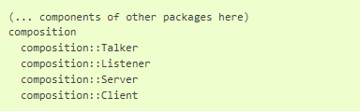
Composing multiple nodes in a single process
Goal: Compose multiple nodes into a single process.
1: Run the demos:
The demos use executables from rclcpp_components, ros2component, and composition packages, and can be run with the following commands.
2: Discover available components
To see what components are registered and available in the workspace, execute the following in a shell:
ros2 component types
The terminal will return the list of all available components:

Slide 20
Composing multiple nodes in a single process
Run-time composition using ROS services with a server and client
The example with a server and a client is very similar.
ros2 run rclcpp_components component_container
In the second shell (see server and client source code):
ros2 component load /ComponentManager composition composition::Server
ros2 component load /ComponentManager composition composition::Client
In this case the client sends a request to the server, the server processes the request and replies with a response, and the client prints the received response.
Compile time composition using ROS services
The executable contains all four components from above: talker and listener as well as server and client.
ros2 run composition manual_composition
This should show repeated messages from both pairs, the talker and the listener as well as the server and the client.

Slide 21
Composing multiple nodes in a single process
Run-time composition using dlopen
This demo presents an alternative to run-time composition by creating a generic container process and explicitly passing the libraries to load without using ROS interfaces. The process will open each library and create one instance of each “rclcpp::Node” class in the library source code).
ros2 run composition dlopen_composition `ros2 pkg prefix composition`/lib/libtalker_component.so `ros2 pkg prefix composition`/lib/liblistener_component.so
Now the shell should show repeated output for each sent and received message.
Composition using launch actions
While the command line tools are useful for debugging and diagnosing component configurations, it is frequently more convenient to start a set of components at the same time. To automate this action, we can use the functionality in ros2 launch
ros2 launch composition composition_demo.launch.py

Slide 22
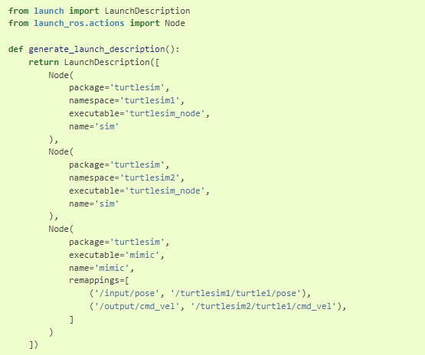
Creating a launch file
Goal: Create a launch file to run a complex ROS 2 system.
Launch files written in Python, XML, or YAML can start and stop different nodes as well as trigger and act on various events.
Step 1: Setup
Create a directory to store your launch files:
mkdir launch
Step 2: Write the launch file
Python launch file example

Slide 23

Creating a launch file
Step 3: ros2 launch
To run the launch file created above, enter into the directory you created earlier and run the following command:
cd launch
ros2 launch turtlesim_mimic_launch.py
Two turtlesim windows will open, and you will see the following [INFO] messages telling you which nodes your launch file has started:
To see the system in action, open a new terminal and run the ros2 topic pub command on the /turtlesim1/turtle1/cmd_vel topic to get the first turtle moving:
ros2 topic pub -r 1 /turtlesim1/turtle1/cmd_vel geometry_msgs/msg/Twist "{linear: {x: 2.0, y: 0.0, z: 0.0}, angular: {x: 0.0, y: 0.0, z: -1.8}}“

Slide 24
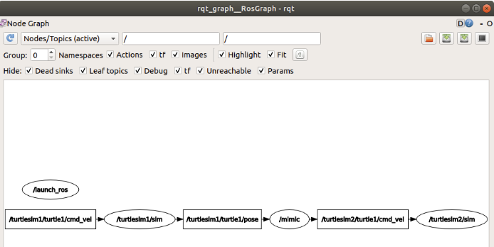
Creating a launch file
Step 4: Introspect the system with rqt_graph
While the system is still running, open a new terminal and run rqt_graph to get a better idea of the relationship between the nodes in your launch file.
Run the command:
rqt_graph

Slide 25
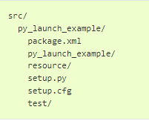
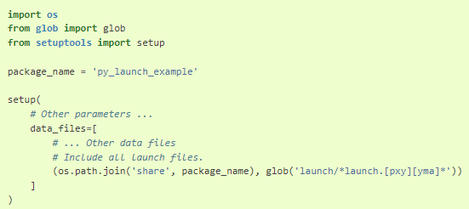
Integrating launch files into ROS2 packages
Goal: Add a launch file to a ROS 2 package
Step 1: Create a package
Create a workspace for the package to live in:
mkdir -p launch_ws/src
cd launch_ws/src
ros2 pkg create py_launch_example --build-type ament_python
Step 2: Creating the structure to hold launch files
By convention, all launch files for a package are stored in the launch directory inside of the package. Make sure to create a launch directory at the top-level of the package you created above.

Slide 26
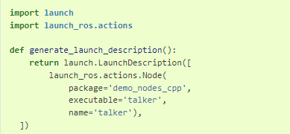
Integrating launch files into ROS2 packages
Step 3: Writing the launch file
Inside your launch directory, create a new launch file called my_script_launch.py. _launch.py is recommended, but not required, as the file suffix for Python launch files.
Your launch file should define the generate_launch_description() function which returns a launch.LaunchDescription() to be used by the ros2 launch verb.
Step 4: Building and running the launch file
Go to the top-level of the workspace, and build it:
colcon build
After the colcon build has been successful and you’ve sourced the workspace, you should be able to run the launch file as follows:
ros2 launch py_launch_example my_script_launch.py

Slide 27
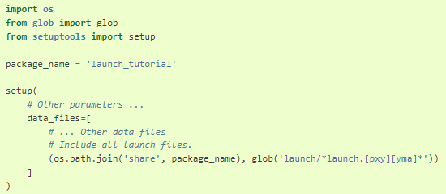
Using substitutions
Goal: Learn about substitutions in ROS 2 launch files.
Step 1: Create a setup the package
Create a new package of build_type ament_python called launch_tutorial:
ros2 pkg create launch_tutorial --build-type ament_python
mkdir launch_tutorial/launch
Finally, make sure to add in changes to the setup.py of the package so that the launch files will be installed:

Slide 28
Using substitutions
Step 2: Parent launch file
In this step we should create a launch file that will call and pass arguments to another launch file. To do this we will create an example_main.launch.py file in the launch folder of the launch_tutorial package.
Step 3: Substitutions example launch file
We should create an example_substitutions.launch.py file in the same folder.
Step 4: Build the package
Go to the root of the workspace, and build the package:
colcon build

Slide 29
Using event handlers
Goal: Learn about event handlers in ROS 2 launch files
Create a new file called example_event_handlers.launch.py file in the launch folder of the launch_tutorial package.
Build the package
Go to the root of the workspace, and build the package:
colcon build
Also remember to source the workspace after building.
Launching example
Now you can launch the example_event_handlers.launch.py file using the ros2 launch command.
ros2 launch launch_tutorial example_event_handlers.launch.py turtlesim_ns:='turtlesim3' use_provided_red:='True' new_background_r:=200
This will do the following:
Start a turtlesim node with a blue background
Spawn the second turtle
Change the color to purple
Change the color to pink after two seconds if the provided background_r argument is 200 and use_provided_red argument is True
Shutdown the launch file when the turtlesim window is closed

Slide 30
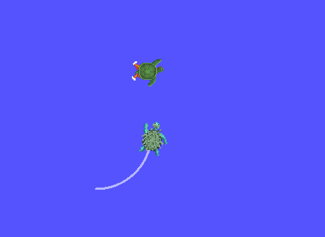
Introducing tf2
Goal: Run a turtlesim demo and see some of the power of tf2 in a multi-robot example using turtlesim.
Step 1: Install the demo
sudo apt-get install ros-foxy-turtle-tf2-py ros-foxy-tf2-tools ros-foxy-tf-transformations
Step 2: Running the demo
ros2 launch turtle_tf2_py turtle_tf2_demo.launch.py
You will see the turtlesim start with two turtles.

Slide 31
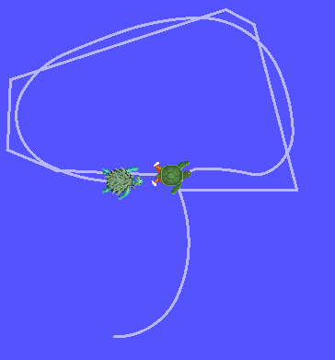
Introducing tf2
In the second terminal window type the following command:
Once the turtlesim is started you can drive the central turtle around in the turtlesim using the keyboard arrow keys, select the second terminal window so that your keystrokes will be captured to drive the turtle.

Slide 32

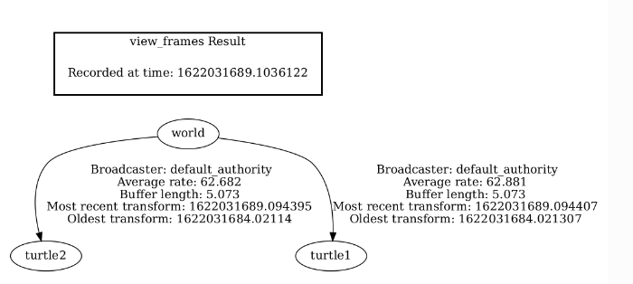
Introducing tf2
tf2 tools
Now let’s look at how tf2 is being used to create this demo. We can use tf2_tools to look at what tf2 is doing behind the scenes.
Using view_frames
view_frames creates a diagram of the frames being broadcasted by tf2 over ROS.
ros2 run tf2_tools view_frames.py
You will see:
Here a tf2 listener is listening to the frames that are being broadcasted over ROS and drawing a tree of how the frames are connected. To view the tree, open the resulting frames.pdf with PDF viewer.

Slide 33
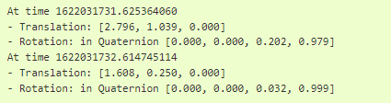
Introducing tf2
Using tf2_echo
tf2_echo reports the transform between any two frames broadcasted over ROS
ros2 run tf2_ros tf2_echo [reference_frame] [target_frame]
You will see the transform displayed as the tf2_echo listener receives the frames broadcasted over ROS2.
As you drive your turtle around you will see the transform change as the two turtles move relative to each other.

Slide 34
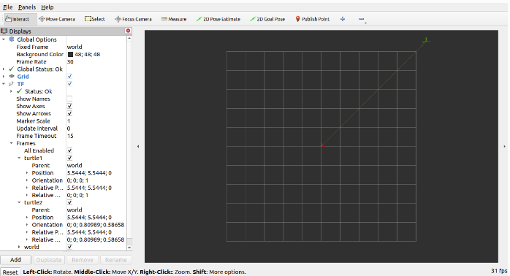
Introducing tf2
rviz and tf2
rviz is a visualization tool that is useful for examining tf2 frames. Let’s look at our turtle frames using rviz. Let’s start rviz with the turtle_rviz.rviz configuration file using the -d option:
ros2 run rviz2 rviz2 -d $(ros2 pkg prefix --share turtle_tf2_py)/rviz/turtle_rviz.rviz

Slide 35
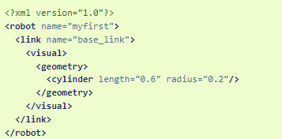
Building a visual robot model from scratch
Goal: Learn how to build a visual model of a robot that you can view in Rviz
Before continuing, make sure you have the joint_state_publisher package installed. If you installed urdf_tutorial binaries, this should already be the case. If not, please update your installation to include that package (use rosdep to check)
To make sure the shapes defined in the urdf files are parsed correctly, the Linux environment variable LC_NUMERIC needs to be set to en_US.UTF-8.
echo 'export LC_NUMERIC="en_US.UTF-8"' >> ~/.bashrc
One Shape
First, we’re just going to explore one simple shape. Here’s about as simple as a urdf as you can make.
To translate the XML into English, this is a robot with the name myfirst, that contains only one link (a.k.a. part), whose visual component is just a cylinder 0.6 meters long with a 0.2 meter radius.

Slide 36
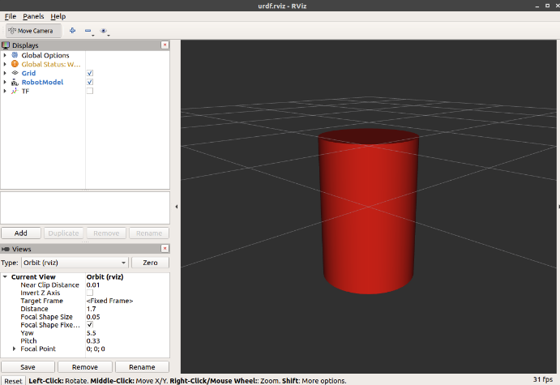
Building a visual robot model from scratch
To examine the model, launch the display.launch.py file
ros2 launch urdf_tutorial display.launch.py model:=urdf/01-myfirst.urdf
This does three things:
Loads the specified model and saves it as a parameter
Runs nodes to publish sensor_msgs/msg/JointState and transforms (more on these later)
Starts Rviz with a configuration file

Slide 37
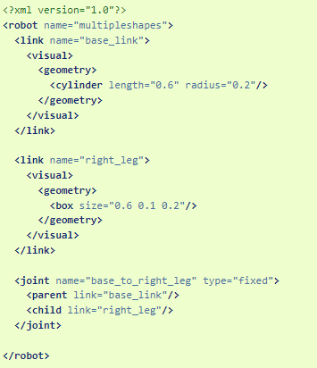
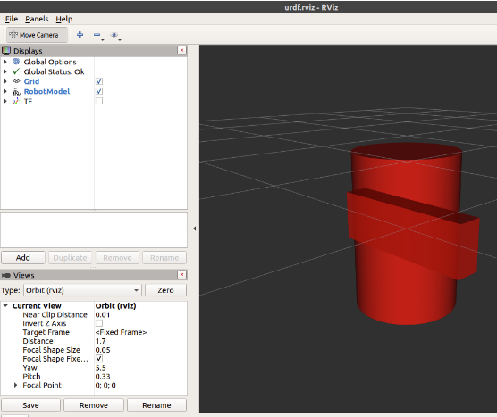
Building a visual robot model from scratch
Multiple shapes
Now let’s look at how to add multiple shapes/links. If we just add more link elements to the urdf, the parser won’t know where to put them. So, we have to add joints. Joint elements can refer to both flexible and inflexible joints.

Slide 38
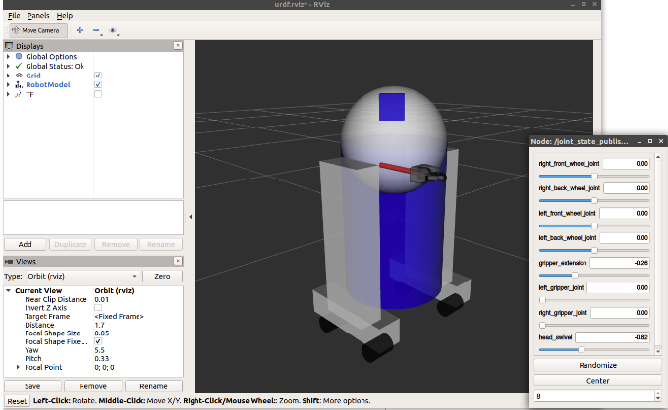
Building a movable robot model
Goal: Learn how to define movable joints in URDF
To visualize and control this model, run the same command as the last slide:
ros2 launch urdf_tutorial display.launch.py model:=urdf/06-flexible.urdf
However now this will also pop up a GUI that allows you to control the values of all the non-fixed joints. Play with the model some and see how it moves.

Slide 39
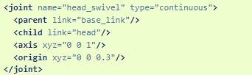
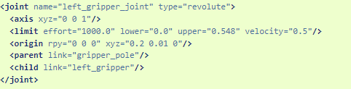
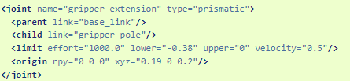
Building a movable robot model
The Head
The connection between the body and the head is a continuous joint, meaning that it can take on any angle from negative infinity to positive infinity.
The Gripper
Both the right and the left gripper joints are modeled as revolute joints. This means that they rotate in the same way that the continuous joints do, but they have strict limits. Hence, we must include the limit tag specifying the upper and lower limits of the joint (in radians). We also must specify a maximum velocity and effort for this.
The Gripper Arm
The gripper arm is a different kind of joint, namely a prismatic joint. This means that it moves along an axis, not around it. This translational movement is what allows our robot model to extend and retract its gripper arm.

Slide 40
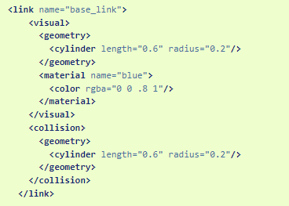
Adding physical and collision properties
Goal: Learn how to add collision and inertial properties to links, and how to add joint dynamics to joint.
In order to get collision detection to work or to simulate the robot, we need to define a collision element as well.
The collision element is a direct subelement of the link object, at the same level as the visual tag.
The collision element defines its shape the same way the visual element does, with a geometry tag. The format for the geometry tag is exactly the same here as with the visual.
You can also specify an origin in the same way as a subelement of the collision tag (as with the visual).

Slide 41
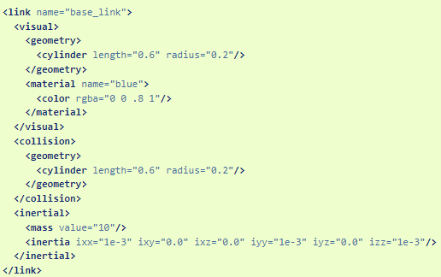
Adding physical and collision properties
Physical Properties
In order to get your model to simulate properly, you need to define several physical properties of your robot, i.e. the properties that a physics engine like Gazebo would need.
Inertia
Every link element being simulated needs an inertial tag. Here is a simple one.
This element is also a subelement of the link object.
The mass is defined in kilograms.
The 3x3 rotational inertia matrix is specified with the inertia element. Since this is symmetrical, it can be represented by only 6 elements, as such.

Slide 42
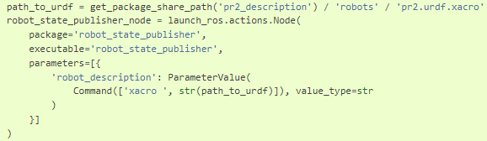
Using Xacro to clean up your code
Goal: Learn some tricks to reduce the amount of code in a URDF file using Xacro
As its name implies, xacro is a macro language for XML. The xacro program runs all of the macros and outputs the result. Typical usage looks something like this:
xacro model.xacro > model.urdf
You can also automatically generate the urdf in a launch file. This is convenient because it stays up to date and doesn’t use up hard drive space. However, it does take time to generate, so be aware that your launch file might take longer to start up.
At the top of the URDF file, you must specify a namespace in order for the file to parse properly. For example, these are the first two lines of a valid xacro file:

Slide 43
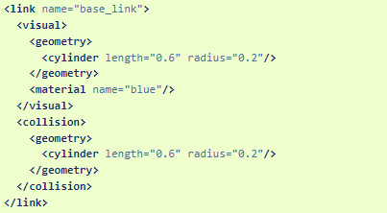
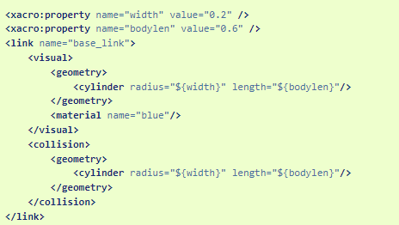
Using Xacro to clean up your code
Constants
Let’s take a quick look at our base_link in R2D2.
The information here is a little redundant. We specify the length and radius of the cylinder twice. Worse, if we want to change that, we need to do so in two different places.
Fortunately, xacro allows you to specify properties which act as constants. Instead, of the above code, we can write this.

Slide 44


Using Xacro to clean up your code
The two values are specified in the first two lines. They can be defined just about anywhere (assuming valid XML), at any level, before or after they are used. Usually they go at the top.
The value of the contents of the ${} construct are then used to replace the ${}. This means you can combine it with other text in the attribute.
This will generate
However, the contents in the ${} don’t have to only be a property, which brings us to our next point.
Math
You can build up arbitrarily complex expressions in the ${} construct using the four basic operations (+,-,*,/), the unary minus, and parenthesis. Examples:
You can also use more than the basic mathematical operations, like sin and cos.

Slide 45

Using Xacro to clean up your code
Macros
Here’s the biggest and most useful component to the xacro package.
Simple Macro
Let’s take a look at a simple useless macro.
This code will generate the following.
The name is not technically a required element, but you need to specify it to be able to use it.
Every instance of the <xacro:$NAME /> is replaced with the contents of the xacro:macro tag.
Note that even though its not exactly the same (the two attributes have switched order), the generated XML is equivalent.
If the xacro with a specified name is not found, it will not be expanded and will NOT generate an error.

Slide 46
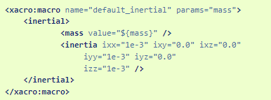
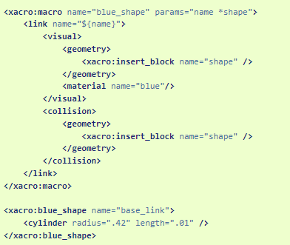
Using Xacro to clean up your code
Parametrized Macro
You can also parameterize macros so that they don’t generate the same exact text every time. First, let’s take an example of a simple macro used in R2D2.
This can be used with the code
The parameters act just like properties, and you can use them in expressions
You can also use entire blocks as parameters too.

Slide 47
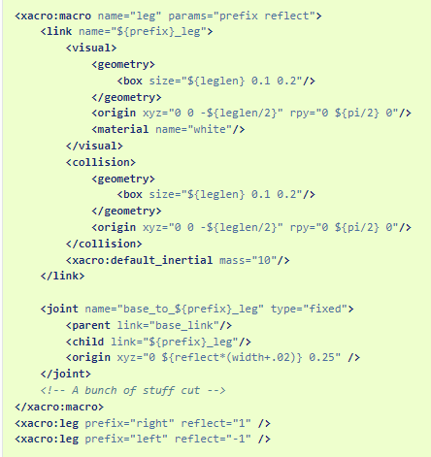
Using Xacro to clean up your code
Practical Usage
The xacro language is rather flexible in what it allows you to do. Here are a few useful ways that xacro is used in the R2D2 model, in addition to the default inertial macro shown above.
ros2 launch urdf_tutorial display.launch.py model:=urdf/08-macroed.urdf.xacro
Leg macro
Often you want to create multiple similar looking objects in different locations. You can use a macro and some simple math to reduce the amount of code you have to write, like we do with R2’s two legs.

Slide 48
Using URDF with robot_state_publisher
Goal: Simulate a walking robot modeled in URDF and view it in Rviz.
First, we create the URDF model describing the robot assembly. Next we write a node which simulates the motion and publishes the JointState and transforms. We then use robot_state_publisher to publish the entire robot state to /tf2
Step 1: Create a package
Step 2: Create a URDF File
Step 3: Publish the state
Step 4: Create a launch file
Step 5: Edit the setup.py file
Step 6: Install the package
Step 7: View the results

Slide 49
Brief break (if on schedule)
Q&A?
Prof. Mehdi pirahandeh
E-mail : mehdi at inha dot ac dot kr

